Slide 1
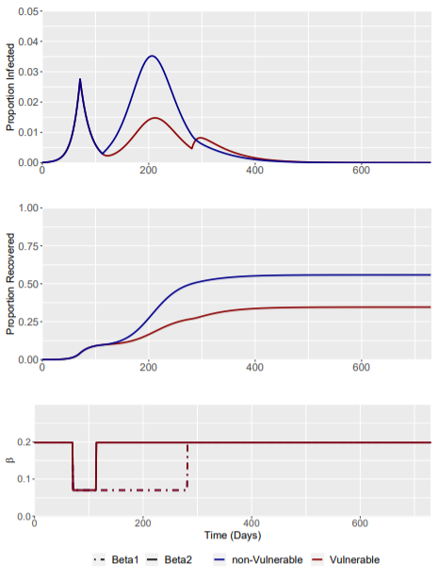
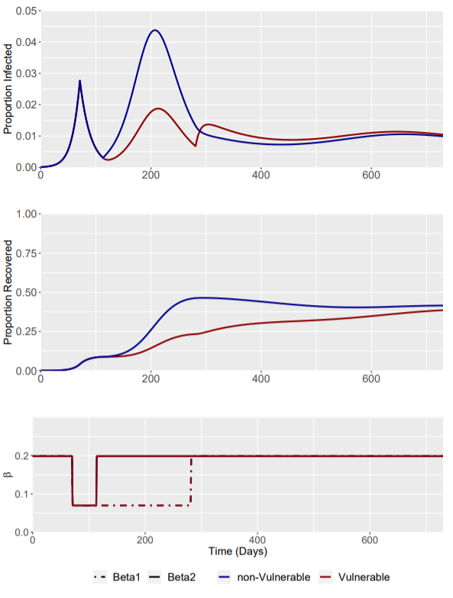
Baseline Parameters
Beta (R0 = 2.8) = 0.327
Beta (R0 = 1.7) = 0.198
Beta (R0 = 0.6) = 0.070
Gamma = 1/8.57 (0.117)
Zeta = 1/365 (0.0027)
Scaling Factor for R0 = 1.7 -> 0.6 is x0.353
SIR Model w/ Updated Parameters
SIRS Model w/ Updated Parameters
Day 71 Trigger = 1 week after lockdown R(t) = 0.0595
Day 71 Trigger = 1 week after lockdown R(t) = 0.0595
Phase | Weeks | Beta1 | Beta2
0 | Up to trigger day | 0.198 | 0.198
1 | 0-6 | 0.07 | 0.07
2 | 6-30 | 0.07 | 0.198
3 | 30 onwards | 0.198 | 0.198
4 | If phase 3 ends | 0.327 | 0.327
Initial Conditions
Sv | Snv | Iv | Inv | Rv | Rnv
0.2 | 0.7999 | 0 | 0.0001 | 0 | 0
No Phase 4 Modelled + Model Scaled to Relative Pop Fraction Size

